Slide 1




II IAA Latin American Symposium on Small Satellites
University of Brasília – Campus Gama
Aerospace Engineering
UNB On-Board Computer Prototype
for CubeSats
G. Lionço, G. Santilli, L. Aguayo
guilherme.lionzo@gmail.com, santilli@aerospace.unb.br, aguayo@unb.br
Argentina,
November 2019

Slide 2
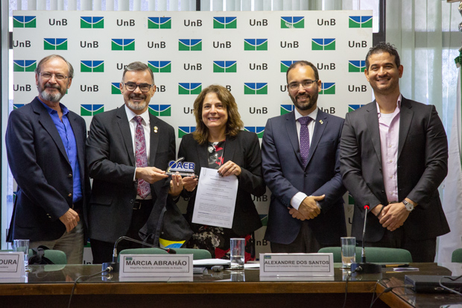
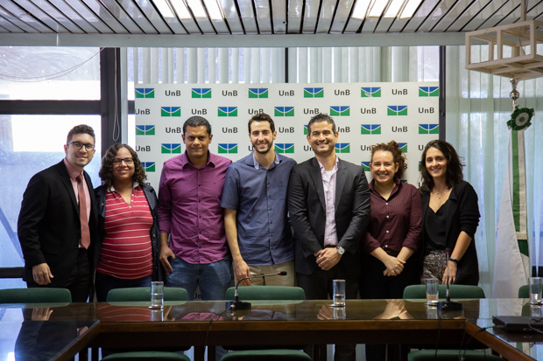
1. Overview
Overview
Research groups of the University of Brasília (UnB) are planning the launch of 3U CubeSat missions as a technology demonstrator [1][2];
Some studies are already ongoing and all missions will require an Onboard Computer (OBC);
Objectives of the UNB OBC
Control an optical camera based on CMOS (Complementary Metal-Oxide-Semiconductor) technology;
Provide control for a Pulsed Plasma Thruster;
To guarantee a high degree of reliability, even using commercial off-the-shelf (COTS) components;
To store useful data in a non-volatile memory, for adequate transmission to a ground station;
To have an anti-locking system;
Change operation modes according to the energy availability.
Fonte:(ISIS, 2019, pág.1).
Figure 1 – 3U CubeSat Platform.
Figure 1 – Members of the Alfa Crux project [2].
II IAA Latin American Symposium on Small Satellites
Notes:
The feasibility of the deployment of 3U CubeSat missions is under study at the University of Brasilia (UnB). These missions are aimed to validate concepts and perform system/subsystem/component testing for future proof-of-concepts prototypes. Initial subsystem requirements for these missions are (a) use of optical cameras for polar shields monitoring, (b) use of a Pulsed Plasma Thruster (PPT) for orbital control studies and (c) the use of an accelerometer to provide a mapping of the Earth gravitational field.
Some studies are already ongoing and all missions will require an Onboard Computer (OBC), a mandatory subsystem responsible for the control, management, and monitoring of all relevant signals needed for the correct operation of the CubeSat. The following text comprises the details of the development of UNB OBC, from its requirements to the hardware and software specifications, as well as some results of the first prototype.

Slide 3
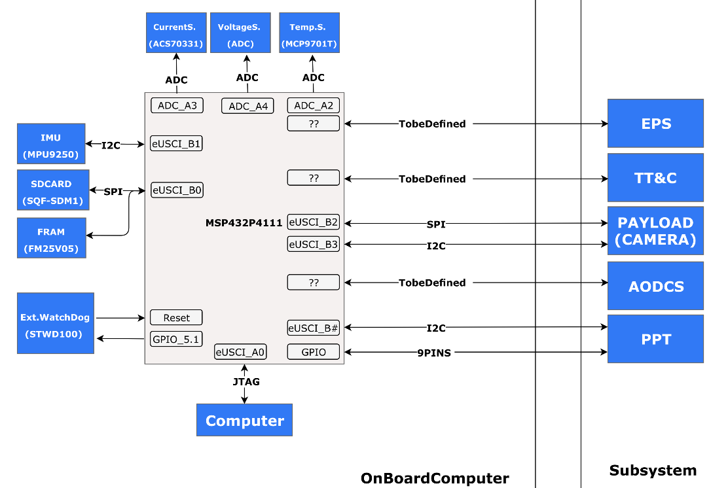
2. Hardware Architecture
Components:
MSP432P4111 (Microcontroller);
512KB FRAM M. (Sof. Back-up) ;
4GB SD Card M. (Telemetry);
ACS70331 (Current S.);
MPU9250 (Inertial Sensor);
MCP9701T (Temp. Sensor);
STWD100 (Ext. Watchdog);
Interfaces:
JTAG (DEBUG);
16bit ISA Bus (Communication Bus);
Figure 2 – Block diagram of the OBC, with interfaces.
II IAA Latin American Symposium on Small Satellites
Notes:
The first step was the assessment of different options for the microcontroller, as it is the component that imposes the main restrictions on the OBC performance. Selection criteria has considered: low power consumption, presence of ADC, SPI, UART, I2C and processing speed (clock rate). Usual COTS components were considered, and to reduce the time for the prototyping, we also required that a development kit was ready to be acquired from the corresponding manufacturer.
The second step was the dimensioning of the memory subsystem, responsible to store data from OBC processing, and composed by two subunits. The first stores telemetry and payload data, and the second stores a backup of the embedded software.
In addition to the microprocessor, memory and peripherical subsystems, the OBC unit has two main interfaces, one for debugging and other for communicating with other satellite subsystems.

Slide 4
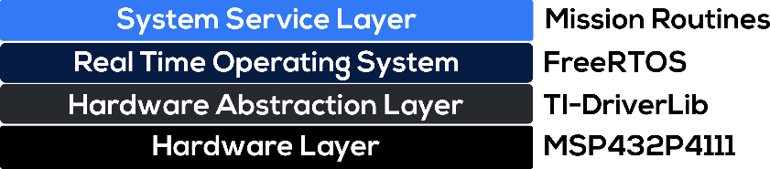
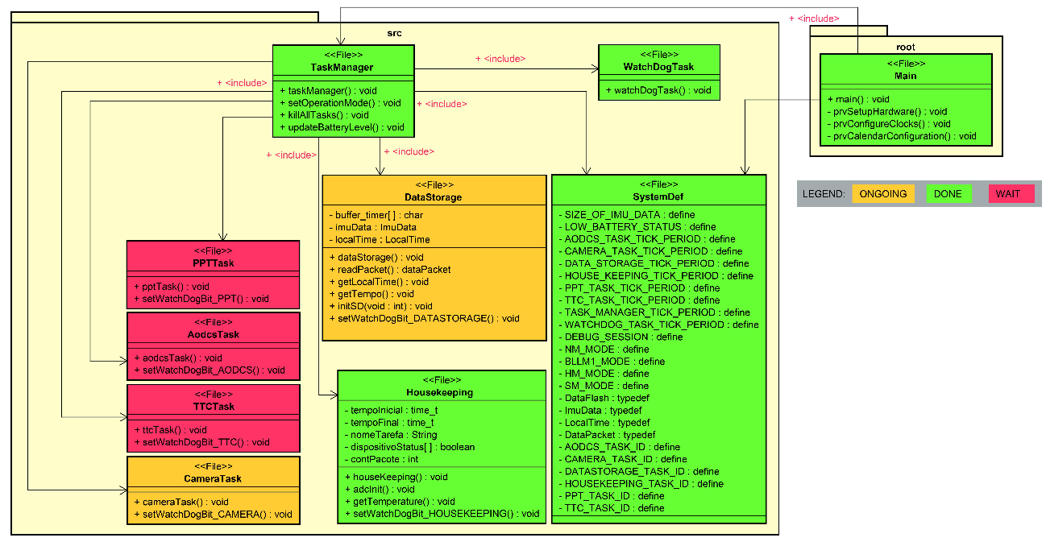
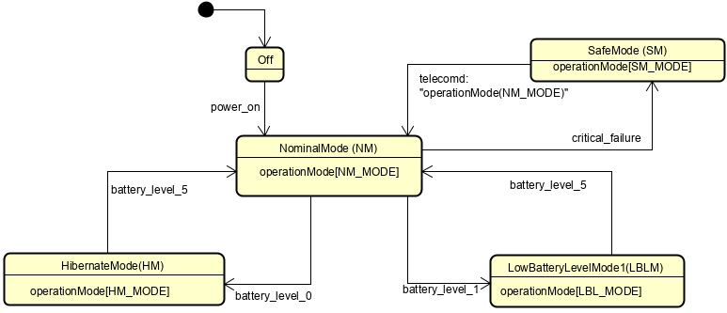
3. Software Architecture
The Layered Architecture provide a better software usability and maintenance;
The Hardware Abstraction Layer (HAL) is performed by the TI-DriverLib [3] and the FreeRTOS was used to meet the requirements of Hard RTOS [4].
The State Machine has four operation modes;
one for control (TaskManager), one for data collection (HouseKeeping), one for data storage (DataStorage), one for software locking control (WatchDogTask), and 5 to handle CubeSat subsystems functionalities.
Figure 3 – Layered software architecture.
Figure 4 – System Service Layer State Machine Diagram.
Figure 5 – System File Diagram.
II IAA Latin American Symposium on Small Satellites
Notes:
As depicted in Figure 2, a layered approach architecture was defined, in order to provide better software usability and maintenance
Here we focus only on the SSL, the layer with the main development effort. An UML extension, FuncionalC [12], allows the modeling of systems using C language, the one chosen for the code writing and testing. It is worth mentioning that, at this stage of prototyping, the pre-launching and deployment stages were not considered.

Slide 5
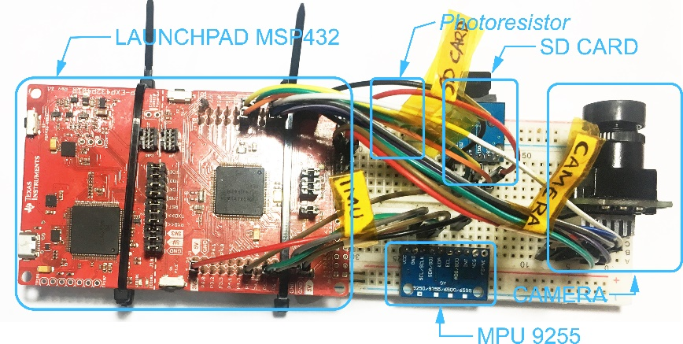
4. Results during the prototyping
Protoboard Test
Using a photoresistor to simulate CubeSat EPS;
Use of commercial off-the-shelf (COTS) components to perform the tests.
Figure 6– Protoboard with COTS components and LaunchPad.
II IAA Latin American Symposium on Small Satellites
Notes:
While the OBC hardware was under construction, the MSP432 LaunchPad kit was used to develop all the main software features to be embedded. A photoresistor was used to simulate the battery level of the CubeSat EPS, as the incidence of light interferes with the amount of energy stored in the EPS.

Slide 6
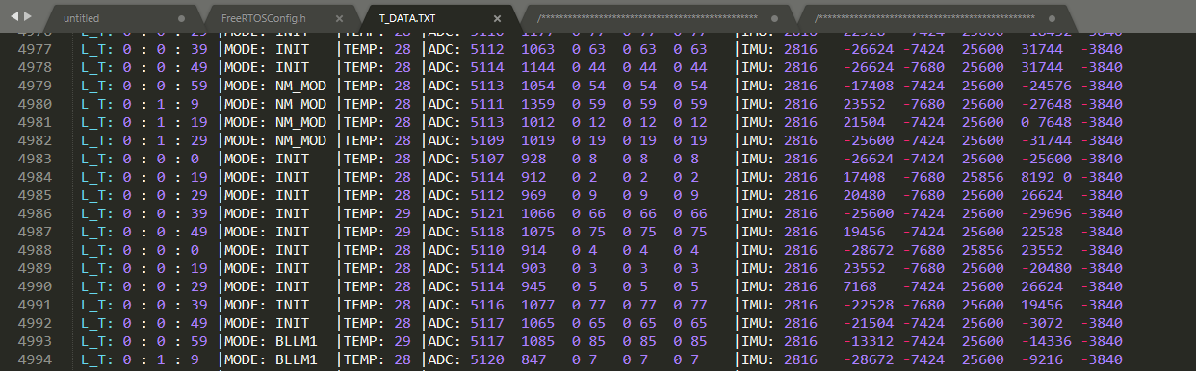
4. Results during the prototyping
Data Acquisition and Storage
Data Acquisition → HouseKeeping Task;
Data Storage → DataStorage Task;
Data were stored in ASCII format, for easy viewing;
Figure 7 – Telemetry data stored on memory card.
II IAA Latin American Symposium on Small Satellites
Notes:
The data acquisition and storage service are performed by the HouseKeeping and DataStorage tasks, respectively. During the tests performed, the data were saved in ASCII format to facilitate debugging

Slide 7
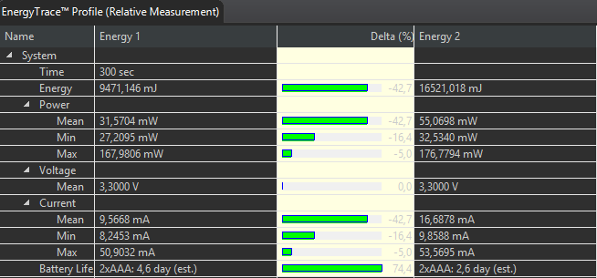
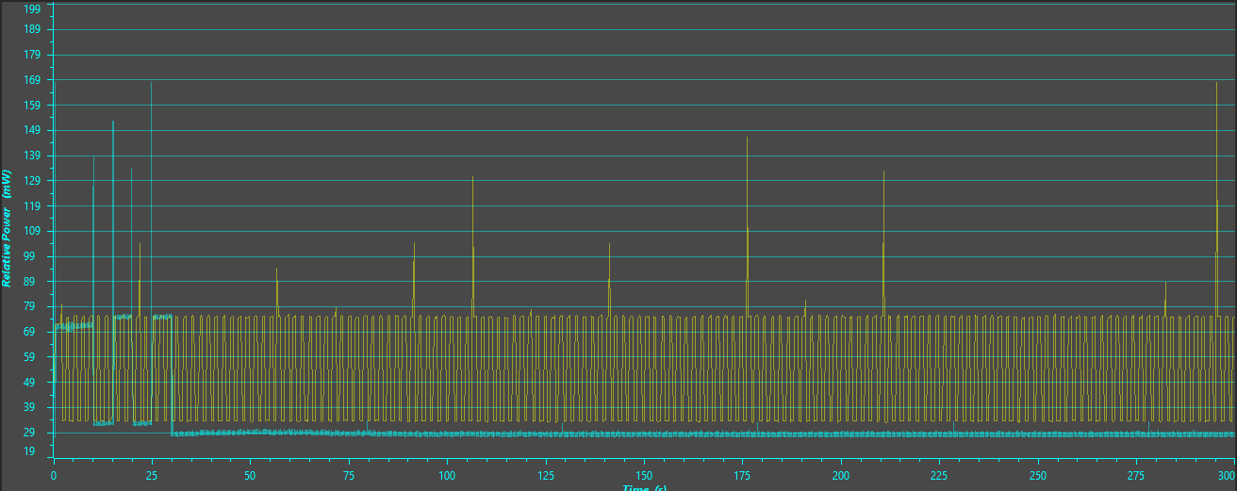
4. Results during the prototyping
Consumption tests were performed using Code Composer Studio's EnergyTrace tool [5];
Hibernation Mode x Nominal Mode
Comparing Nominal Mode with Hibernate Mode, there is a savings of over 40%, increasing battery life by two days.
Figure 8 – Comparison between Hibernation Modes (Blue) and Low Battery (Yellow).
II IAA Latin American Symposium on Small Satellites
Notes:
Consumption tests were performed using Code Composer Studio's EnergyTracer tool. This tool measures the current being consumed on the JTAG / SW bus, so it allows you to calculate the current consumed by the modules / sensors powered by LaunchPad

Slide 8
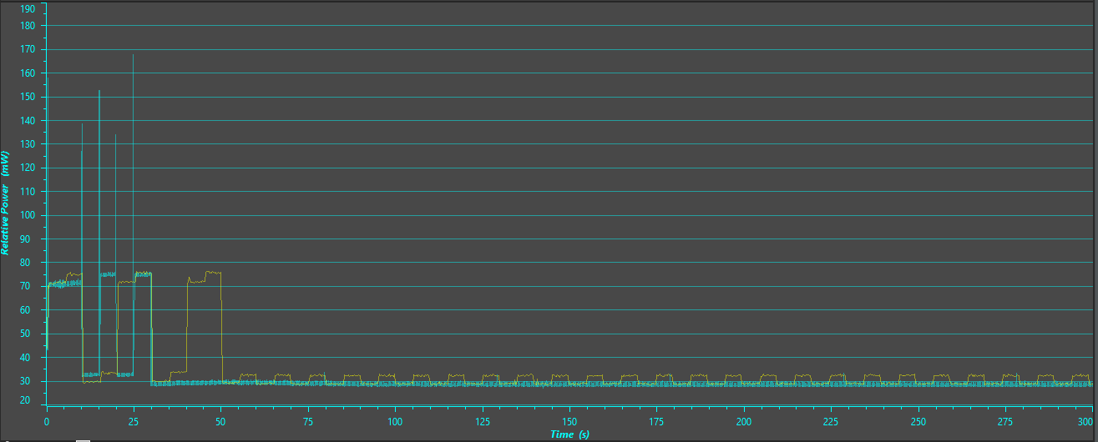
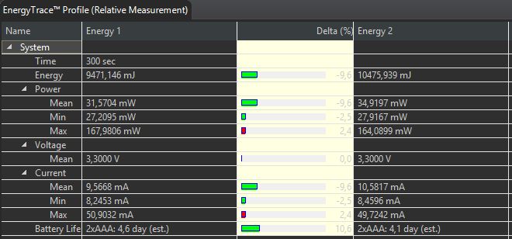
4. Results during the prototyping
Consumption – Hibernation Mode x Low Battery Mode
Comparing Nominal Mode with Hibernate Mode, there is a savings of more than 9.6%, increasing battery life by 0.5 days.
Figure 9 – Comparison between Hibernation Modes (Blue) and Low Battery (Yellow).
II IAA Latin American Symposium on Small Satellites
Notes:
When comparing the performance of low power mode with hibernation mode, there was a 9% energy saving (0.6 days). This saving can be increased by changing the SysTick frequency, the FreeRTOS interrupter, to a lower frequency, e.g. 32KHz. The system in hibernation mode will need to be idle for a long time, so a lower SysTick frequency will be sufficient to perform kernel interrupts and will consume less than a 48MHz clock rate, as was used during the test. Figure 8 shows the comparison in graphical form.

Slide 9
4. Results during the prototyping
Consumption – Hibernation Mode x Low Battery Mode
Comparing Nominal Mode with Hibernate Mode, there is a savings of more than 9.6%, increasing battery life by 0.5 days.
Instead of using a 48MHz in SysTick Interrupter, we have to use a 32KHz.
Figure 9 – Comparison between Hibernation Modes (Blue) and Low Battery (Yellow).
II IAA Latin American Symposium on Small Satellites
Notes:
When comparing the performance of low power mode with hibernation mode, there was a 9% energy saving (0.6 days). This saving can be increased by changing the SysTick frequency, the FreeRTOS interrupter, to a lower frequency, e.g. 32KHz. The system in hibernation mode will need to be idle for a long time, so a lower SysTick frequency will be sufficient to perform kernel interrupts and will consume less than a 48MHz clock rate, as was used during the test. Figure 8 shows the comparison in graphical form.

Slide 10
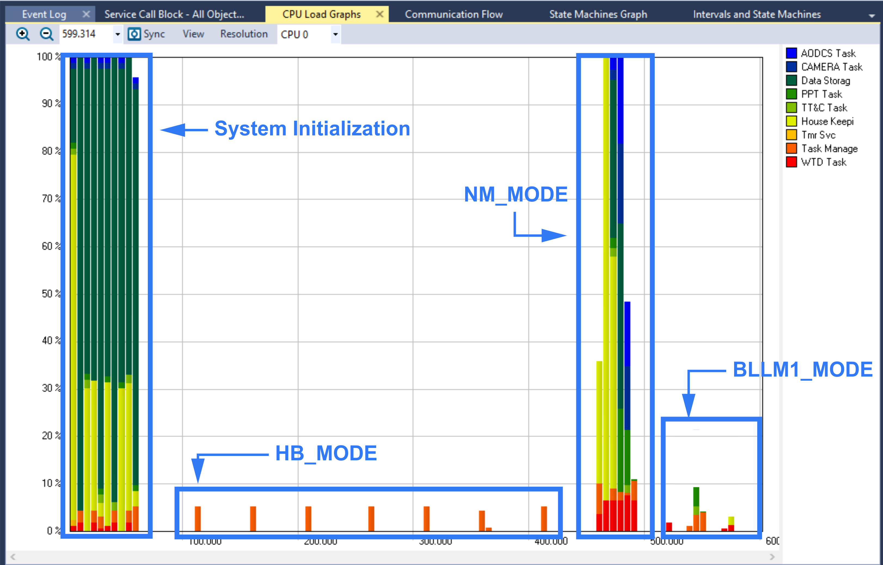
4. Results during the prototyping
Test aided by Tracealyzer tracing tool [6].
System Initialization:
Memory allocation for Handlers, Tasks, Queues, etc.
CPU at 100%;
Task execution period is 100ms;
Hibernation mode :
Only TaskManager are running;
CPU lest than 10%;
Task execution period is 500ms;
Nominal mode :
All the tasks are running;
No CPU limit;
Task execution period is 100ms;
Low Battery mode :
Just WatchDog, HouseKeeping, DataStorage and TaskManager are running;
CPU lest than 10%;
Task execution period is 100ms;
Figure 10 – Tracealyzer snapshoot of the system running.
II IAA Latin American Symposium on Small Satellites
Notes:
To test the OBC state machine, it was used the software Tracealyzer from Percepio [13]. During the tests, it was possible to observe several interesting phenomena. At system startup, there is a high CPU usage, due to tasks, mutex, etc, memory allocation. When the light source was turned off, the system went into low power mode and only TaskManager was activated and running slower. The light source was turned on again and the system went into the nominal mode and all tasks run without CPU limit. After that, the brightness of the light source was decreased and the system was put into the low power mode, only the control (WatchDogTask and TaskManager) and data manipulation (HouseKeeeping and DataStorage) tasks were performed.

Slide 11
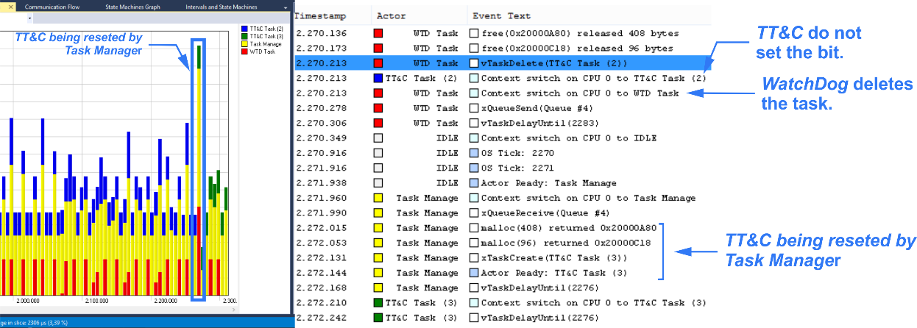
4. Results during the prototyping
Anti-Lock System:
Watchdog at software level;
This approach prevent Single Event Effect (SEE), but not effects caused by Total Dose Ionization (TID) [7];
Figure 11 – Tracealyzer snapshoot of the system running.
II IAA Latin American Symposium on Small Satellites
Notes:
To test Watchdog at software level, a system crash was simulated, causing a failure during the TT&CTask bit setting in the WatchDogTask handler. As expected, WatchDogTask checked the bits and deleted the TT&CTask, as shown in Figure 10. Before the lockup, the TT&CTask had the label TT&C Task(2) [blue] and, after being restarted, changed to TT&CTask(3) [green].

Slide 12
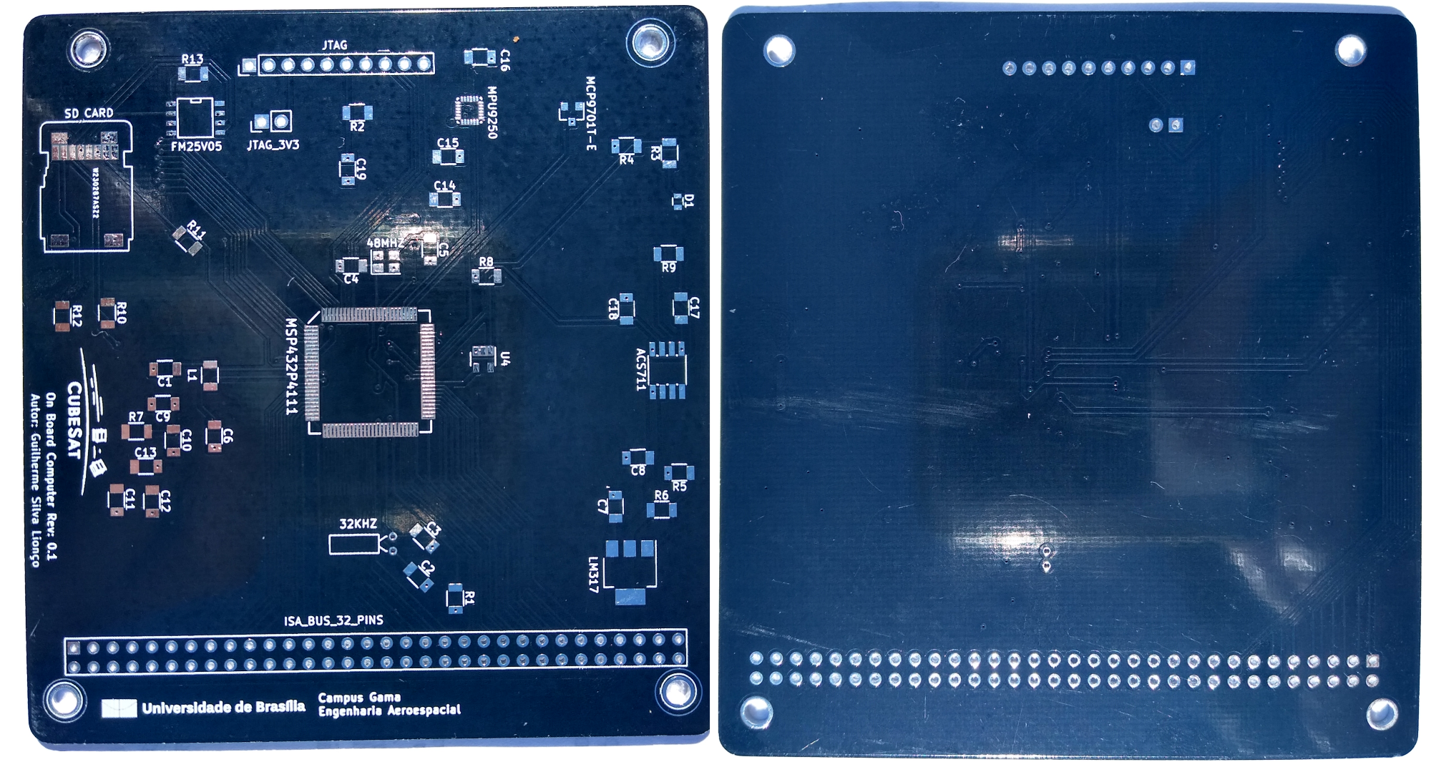
4. Results during the prototyping
Printed Circuit Board:
The PCB was designed using the KiCad EDA;
Two Layers: a signal layer and a ground layer.
1206 SMD package;
To reduce the inductance → Traces with 45° angle corner and as short as possible.
The feed and ground connections were made using vias, saving space and decreasing the Electromagnetic Interference (EMI).
It was not possible to have an intact ground plane and some traces were routed on the bottom layer, which may increase the EMI.
The PCB dimensions are 95.89x90.17mm, which was based on the PC104 specification [8].
Figure 12 – PCB top and bottom view.
II IAA Latin American Symposium on Small Satellites
Notes:
The PCB was designed using the KiCad EDA, an open-source software for circuitry design. The layout had two layers: a signal layer and a ground layer. In order to reduce cost and increase design flexibility, the chosen SMD components were 1206 package (approximately 3.2mm by 1.6mm). This choice allows components to be manually welded without the aid of robotic machinery. All traces were made using a 45° angle for every corner and were as short as possible to reduce inductance. The feed and ground connections were made using vias, saving space and decreasing the Electromagnetic Interference (EMI). It was not possible to have an intact ground plane and some traces were routed on the bottom layer, which may increase the EMI. The PCB dimensions are 95.89x90.17mm, which was based on the PC104 specification [14]. The final result is shown in Figure 11. The PCB manufacturing represents the current stage of the project. The next steps in developing OBC will be shown in section 6.

Slide 13
5. Summary
According to the results, MSP432P4111 is a feasible choice for low power and intermediate performance scenarios. Also, the using of TI-DriverLib as Hardware Abstract Layer helped the Software development, due to its intuitive functions.
The use of FreeRTOS as a real-time operating system is an adequate choice for low RAM microcontrollers. Also, the using of Tracealyzer helped in the software debug, provide a visualization of the run-time behavior or the system.
It was also seen that Watchdog at level software worked as a form of redundancy in cases of partial system lockup, avoid all the OBC reset. In addition, preliminary software can now change state according to some input, for example brightness.
II IAA Latin American Symposium on Small Satellites
Notes:
This work presented the main advances made so far in the prototyping of UNB On Board Computer for the future CubeSat mission of the University of Brasilia. The development was divided into two parts: (a) Hardware, where the microcontroller and peripherals were selected; (b) Software, where the architecture and components for each layer were defined. According to the results, MSP432P4111 is a feasible choice for low power and intermediate performance scenarios. Using FreeRTOS as a real-time operating system is also an adequate choice for low RAM microcontrollers. It was also seen that Watchdog at software level worked as a form of redundancy in cases of partial code lockup. In addition, preliminary software can now change state according to some input, for example brightness.

Slide 14
6. Future Work
A point of extreme priority to be resumed is the purchase and welding of the components, as it was not possible to test the PCB. After this step, the software tests may be performed in the OBC hardware, which means that the consumption and performance will be more accurate than in the TI-Launchpad.
The second point is the use of the 32 KHz clock rate as the SysTick frequency source during satellite hibernation mode. It has been concluded that using a single clock for both high performances and hibernates mode does not make OBC robust in low battery scenarios.
The use of multiple watchdog levels is not sufficient to decrease the risk of radiation effects on OBC. The use of COTS components decreases system reliability and other forms of protection should be considered.
II IAA Latin American Symposium on Small Satellites
Notes:
Some established requirements have not been met due to the time available and the project complexity. All of these requirements will be resumed and implemented over the coming months to complete the first prototype of UnB OBC. A point of extreme priority to be resumed is the purchase and welding of the components, as it was not possible to test the PCB. After this step, the software tests may be performed in the OBC hardware, which means that the consumption and performance will be more accurate than in the TI-LaunchPad. The second point is the use of the 32KHz clock rate as the SysTick frequency source during satellite hibernation mode. It has been concluded that using a single clock for both high performances and hibernates mode does not make OBC robust in low battery scenarios. The use of multiple watchdog levels is not sufficient to decrease the risk of radiation effects on OBC. The use of COTS components decreases system reliability and other forms of protection should be considered.

Slide 15
References
[1] G. Santilli, C. Cappelletti, S. Battistini, C. Vendittozzi, Disaster Management of Remote Areas by Constellation of Cubesats, 67th International Astronautical Congress (IAC 2016), Mexico (2016).
[2] UNB Noticias, Para lançar satélite, UnB fecha parceria com FAP-DF e Agência Espacial Brasileira, Brazil (2019)
[3] TEXAS INSTRUMENTS, USER'S GUIDE MSP432® Peripheral Driver Library. p.14. (2015)
[4] R. Barry, Mastering the FreeRTOS STM Real Time Kernel: A Hands-On Tutorial Guide. p.17. Real Time Engineers Ltd., USA (2016)
[5] TEXAS INSTRUMENTS,Code Composer Studio™ IDE v8.x for MSP430™ MCUs. p.16, USA (2018)
[6] P. AB, Tracealyzer for FreeRTOS. p.1. Percepio AB, USA (2019)
[7] C. Frost and E. Agasid, Small Spacecraft Technology State of the Art. p.97. NASA Ames Research Center, California (2015)
[8] PC/104 Embedded Consortium, PC/104 Specification – version 2. p.16, USA (2008)
II IAA Latin American Symposium on Small Satellites

Slide 16

Thank you!
Muchas Gracias!
II IAA Latin American Symposium on Small Satellites

